Slide 1
Breast Cancer Diagnosis Prediction using machine learning
Pranav Kiran Rajhans
X16149645
MSc Data Analytics
Supervisor : Prof. Christian Horn

Slide 2
CONTENT
Introduction
Motivation
Research question
Methodology
Results and evaluations
Conclusion and future work

Slide 3
INTRODUCTION
Breast cancer is most common cancer among the women in the world
Reasons of breast cancer
Types of breast cancer BRCA 1 and BRCA 2
In this research different machine learning models are used for the detection of breast cancer diagnosis.
Notes:
BREAST CANCER IS MOST COMMON CANCER IN MEN AND WOMEN BUT AMONG THE WOMENS IT IS MORE THAN MENS, IN MENS IT IS ONLY OF 1% AND IN WOMEN IT IS 12% ACCOUNTING FOR 25.1 % OF ALL THE CANCER. THE DEATHS HAPPENED AREOUNG THE WORLD 0.5 MILLION EVERY YEAR. REASON BEHIND THE BREAST CANCER IS HEREDITARY GENES , LIFE STYLE AND ENVIRONMENTAL CONDITIONS. THE TYPES GENES OF BREAST CANCER ARE BRCA 1 AND BRCA 2 WHICH ARE CONSIDERABLY INCREASE THE RISK OF BREAST CANCER.

Slide 4
OBJECTIVE
To classify whether patient has cancer or not
Early detection of breast caner may reduce the intensity of disease and save patients life.
Notes:
THE FROAMTION OF BREAST TUMOR IS DUE TO CELL WHICH INCRESING FIRMLY AND GET STUCK AT ONE PLACE AND LUMP OF THE CELL IS FORMED. SOMETIMES THE LUMP IS FORMED BY THE CELLS IS JUST THE CELL AND NOT CANCEROUS CELL SO SPECIALIST NEED TO PAY AN ATTENTION TOWARDS SUCH THINGS WHILE DISGNOSE THE TUMOR.
EARLY DETECTION MAY RESUDE THE INTENSITY OF THE DISEASE AND THE LIVE OF THE PATIESNT MAY SAVED.

Slide 5
RESEARCH QUESTION
“How many false negative decisions of malignant and benign breast tumor can be correctly predicted by implementing the machine learning models”
Notes:
WHY NEGATIVE VALUES?? AND EXPLAIN

Slide 6
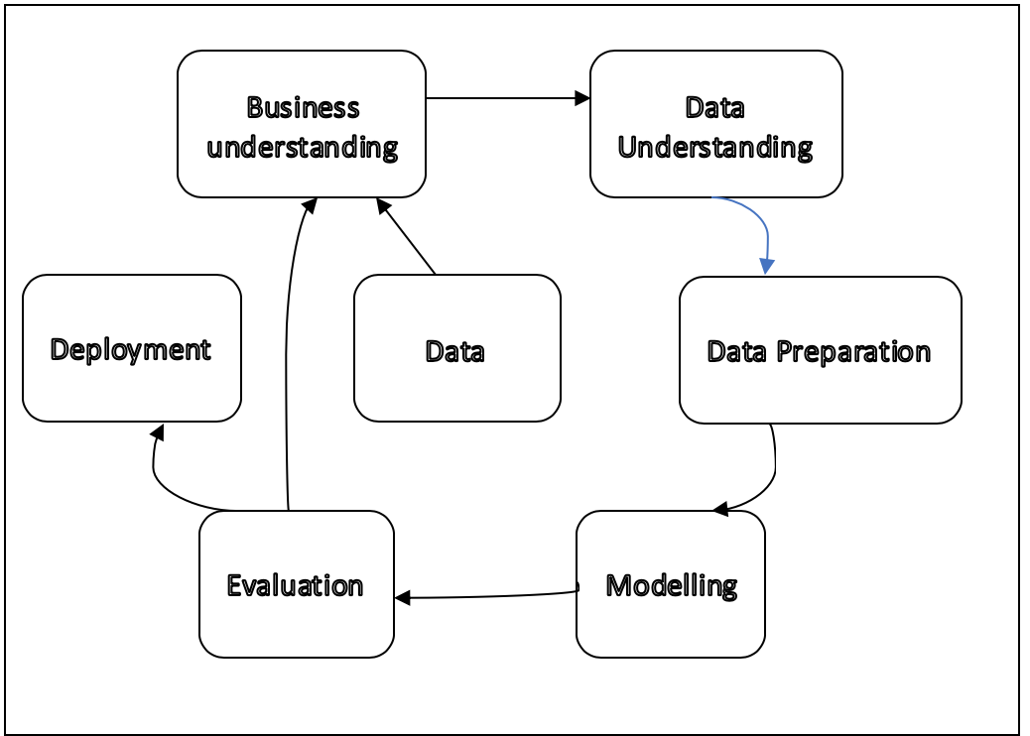
METHODOLOGY
Business understanding-
Research project plan
Data understanding-
Data selection
Data preparation-
Data cleaning and preprocessing
Modeling-
Model building and technique selection.
Evaluation-
Evaluate the result
Figure : CRISP-DM Process
Notes:
THE MAIN METHODOLOGY IN THIS RESEARCH IS USED IS CROSS INDUSTRY STANDARD PROCESS FOR THE DATA MINING.
THESE ARE THE 6 STEPS
BUSINESS UNDERSTANDING :- THE RESEARCH PROJECT PLAN
DATA UNDERSTANDING ---\.
TO UNDERSTAND WHICH VARIBALES ARE IMPORATANT AND THE CORRELATION BETWEEN THE VARIBALES FEATURE SELECTION ALGORITHM IS USED AFTER THAT SOME STATITICAL METHODS ARE USED FOR THE PINCIPAL COMPONENT ANALYSIS TEST
DATA PREPARATION --------/
Data Divided in to two parts 70%training and
MODELING :- DIFFERENT MACHINE LEARNING TECHNIQUES ARE USED FOR THE RESEARCH PROJECT
EVALUATION :- RESULT OF THESE METHODS BASED ON ACCURACY SENSITIVITY AND FALSE NEGATIVE VALUES PREDICTED FROM THE CONFUSION MATRIX

Slide 7
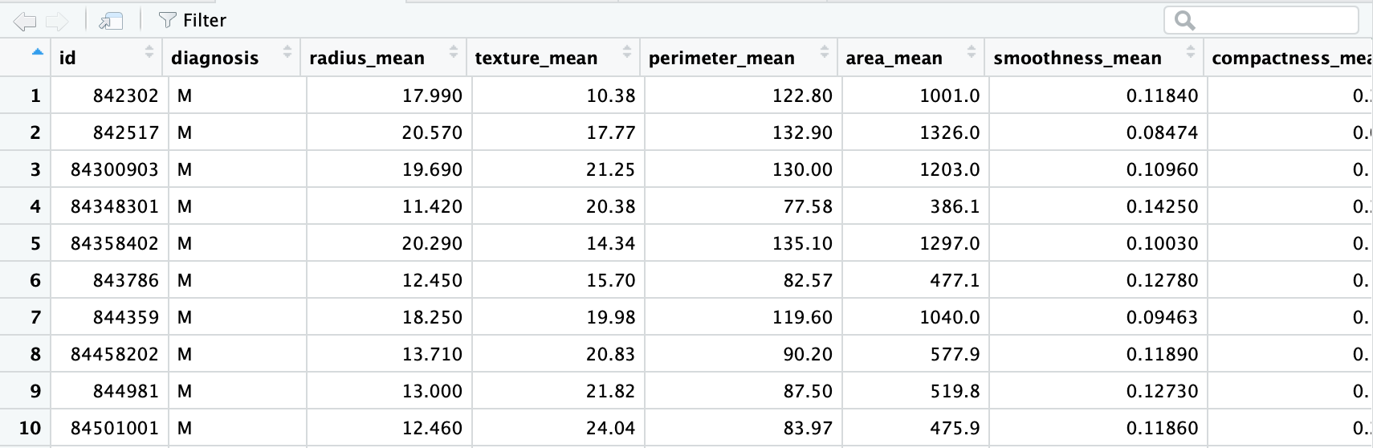
DATA
Source :
https://archive.ics.uci.edu/ml/datasets/Breast+Cancer+Wisconsin+%28Diagnostic%29

Slide 8
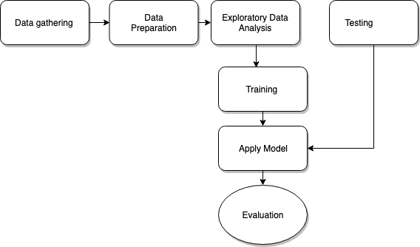
Figure: Architecture of the project

Slide 9
DATA UNDERSTANDING AND PREPARATION
Data preprocessing
Null value removal
Unrequired column removal
Exploration techniques are used to understand the data
Boruta
Correlation plot
Some statistical methods are used for the exploration of the data
Bartlett's test
Kaiser-Meyer-Olkin (KMO)
Notes:
BORUTA IS WRAPPER TYPE FEATURE SELECTION METHOD WHICH SHOWS THE IMPORATANT VARIBALES FROM THE DATA SET ON THE BASIS OF MAXIMUM Z SCORE WHICH FEATURE HAS. Z SCORE IS NOTHING BUT THE NUMBER OF STANDARD DEVIATION FROM THE MEAN A DATA POINT IS.
GREEN INDICATED THE IMPORTANT VARIBALES WHICH HAS HIGHEST IMPACT ON THE DEPENDENT VARIBALE.
BLUE INDICATED WHICH ARE NOT GOOD VARIBALES TO USE IN THE MODEL tentative
YELLOW VARIBALES ARE MODERATE IMPORATANT VARIABLES
CORREALTION PLOT :
1 perfect
0.80 to 1.0 very strong
0.60 to 0.80 strong
Bartlett test
KMO KAISER MEYER OLKIN TEST IS FOR THE SAMPLING ADEQUACY FRO EASCH MODEL

Slide 10
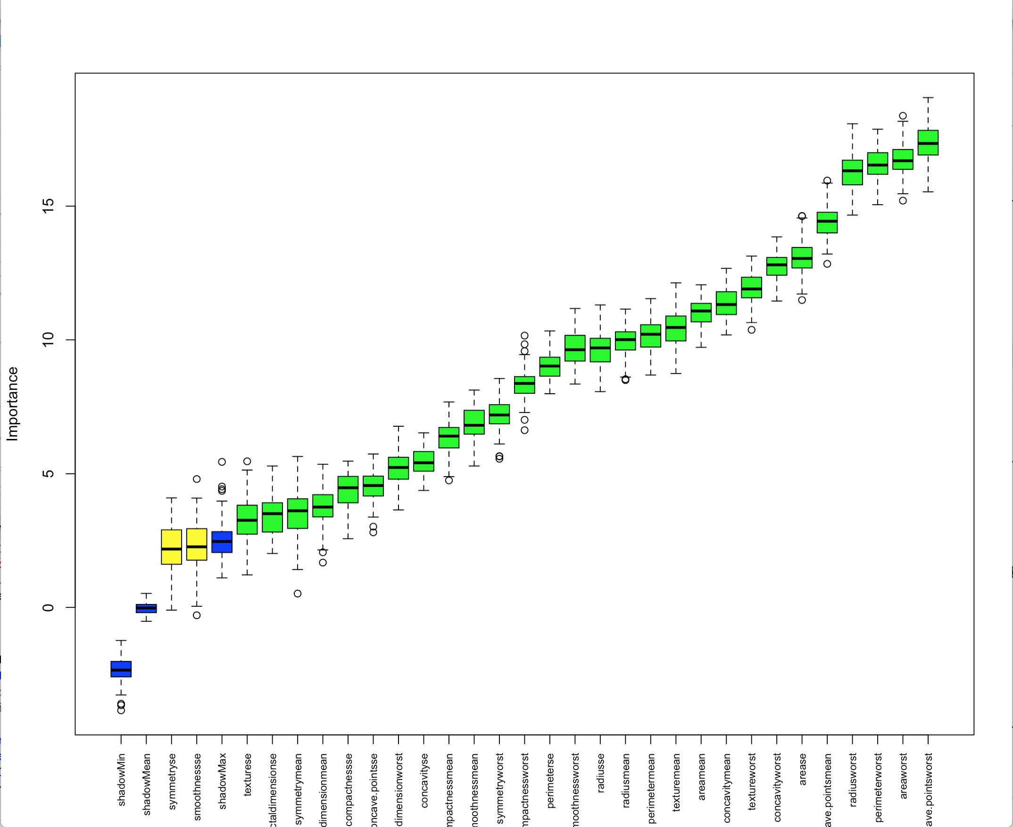
Figure: Boruta

Slide 11
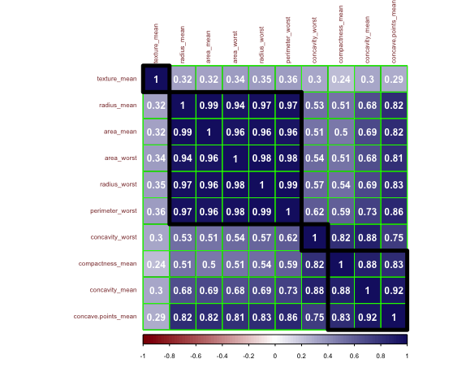
Figure : Correlation Plot

Slide 12
MODELING
Random Forest
K-Nearest Neighbor
Support Vector Machine
Gradient Boosting Model

Slide 13
RESULT AND EVALUATION
Random Forest -
This machine learning method is suitable for classification problem.
Accuracy | 94.08
Sensitivity | 93.85
False Negative Value | 2

Slide 14
K-Nearest Neighbor –
This generalized algorithm use for the prediction of breast caner
diagnosis.
Accuracy | 94.67
Sensitivity | 94.87
False Negative Value | 2
Notes:
Lazy learning algorithm

Slide 15
Support Vector Machine –
Support Vector Machine perform well on non-linearly separable data
with the help of different kernels.
Accuracy | 94.76
Sensitivity | 93.85
False Negative Value | 1

Slide 16
Gradient Boosting Machine –
Gradient Boosting Machine is the best model for classification problem
as well as Gradient Boosting Machines has capability to turn weak learners
into strong learners
Accuracy | 95.27
Sensitivity | 98.40
False Negative Value | 7

Slide 17
EVALUATION
Model Name | Accuracy | Sensitivity | False Negative
Random Forest | 94.08 | 93.85 | 2
K-Nearest Neighbor | 94.67 | 94.87 | 2
Support Vector Machine | 94.76 | 93.85 | 1
Gradient Boosting Machine | 95.27 | 98.40 | 7

Slide 18
CONCLUSION AND FUTURE SCOPE
In this research breast cancer diagnosis prediction using machine
learning models is proposed
In overall evaluation, Gradient Boosting Machines perform better than
other machine learning models
In the near future these operations can be perform on different data set
or on the different mammograms images.

Slide 19
Thank you

